Slide 1
Association Rules
Prof. Navneet Goyal
BITS, Pilani
Notes:
Dr. Navneet Goyal, BITS,Pilani

Slide 2
Association Rules &
Frequent Itemsets
Market-Basket Analysis
Grocery Store: Large no. of ITEMS
Customers fill their market baskets with subset of items
98% of people who purchase diapers also buy beer
Used for shelf management
Used for deciding whether an item should be put on sale
Other interesting applications
  Basket=documents, Items=words
  Words appearing frequently together in documents may represent phrases or linked concepts. Can be used for intelligence gathering.
  Basket=documents, Items= sentences
Two documents with many of the same sentences could represent plagiarism or mirror sites on the Web.
Notes:
Dr. Navneet Goyal, BITS,Pilani

Slide 3
Some Interesting Observations
How many of you have done online shopping?
How many of you use VAS?
How many of you download apps on your phone?
How many of you see movies using VOD services of DTH ?
How many of you watch videos on Youtube?
What is common an all the above?

Slide 4
Association Rules
Purchasing of one product when another product is purchased represents an AR
Used mainly in retail stores to
    Assist in marketing
    Shelf management
    Inventory control
Faults in Telecommunication Networks
Transaction Database
Item-sets, Frequent or large item-sets
Support & Confidence of AR
Notes:
Dr. Navneet Goyal, BITS,Pilani
Conf = sup(LHS U RHS)
T=sup(LHS U RHS)/sup(LHS)

Slide 5
Association Rules
A rule must have some minimum user-specified confidence
  1 & 2 => 3 has 90% confidence if when a customer bought 1 and 2, in 90% of cases, the customer also bought 3.
A rule must have some minimum user-specified support
  1 & 2 => 3 should hold in some minimum percentage of transactions to have business value
AR X => Y holds with confidence T, if T% of transactions in DB that support X also support Y
Notes:
Dr. Navneet Goyal, BITS,Pilani
Conf = sup(LHS U RHS)
T=sup(LHS U RHS)/sup(LHS)

Slide 6
Support & Confidence
I=Set of all items
D=Transaction Database
AR A=>B has support s if s is the %age of Txs in D that contain AUB (both A & B)
s(A=>B )=P(AUB)
AR A=>B has confidence c in D if c is the %age of Txs in D containing A that also contain B
c(A=>B)=P (B/A)
= s(AUB)/s(A)
=support_count(AUB)/ support_count(A)
Notes:
Dr. Navneet Goyal, BITS,Pilani
Conf = sup(LHS U RHS)
T=sup(LHS U RHS)/sup(LHS)

Slide 7
Support & Confidence
If support counts of A, B, and AUB are found, it is straightforward to derive the corresponding ARs A=>B and B=>A and check whether they are strong
Problem of mining ARs is thus reduced to mining frequent itemsets (FIs)
2 Step Process
  Find all frequent Itemsets is all itemsets satisfying min_sup
  Generate strong ARs from frequent itemsets ie ARs satisfying min_sup & min_conf
Notes:
Dr. Navneet Goyal, BITS,Pilani
Conf = sup(LHS U RHS)
T=sup(LHS U RHS)/sup(LHS)

Slide 8
Mining FIs
If min_sup is set low, there are a huge number of FIs since all subsets of a FI are also frequent
A FI of length 100 will have frequent 1-itemsets, frequent 2-itemsets and so on…
Total number of FIs it contains is:
¹⁰⁰C₁ + ¹⁰⁰C₂ +…+¹⁰⁰C₁₀₀ = 2¹⁰⁰-1
¹⁰⁰C₁
¹⁰⁰C₂
Notes:
Dr. Navneet Goyal, BITS,Pilani
Conf = sup(LHS U RHS)
T=sup(LHS U RHS)/sup(LHS)

Slide 9
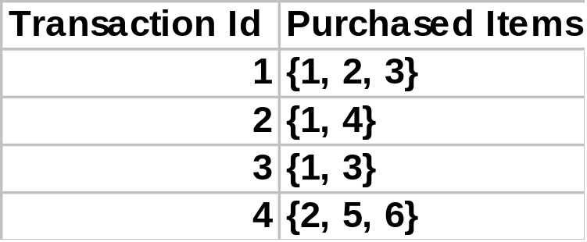
Example
Transaction Database
For minimum support = 50%, minimum confidence = 50%, we have the following rules
  1 => 3 with 50% support and 66% confidence
  3 => 1 with 50% support and 100% confidence
Notes:
Dr. Navneet Goyal, BITS,Pilani

Slide 10
Frequent Itemsets (FIs)
Algorithms for finding FIs
Apriori (prior knowledge of FI properties)
Frequent-Pattern Growth (FP Growth)
Sampling
Partitioning
Notes:
Dr. Navneet Goyal, BITS,Pilani
Conf = sup(LHS U RHS)
T=sup(LHS U RHS)/sup(LHS)

Slide 11
Apriori Algorithm
(Boolean ARs)
Candidate Generation
Level-wise search
Frequent 1-itemset (L₁) is found
Frequent 2-itemset (L₂) is found & so on…
Until no more Frequent k-itemsets (L_{k}) can be found
Finding each L_{k} requires one pass
Apriori Property
“All nonempty subsets of a FI must also be frequent”
P(I) < min_sup ➔ P(I U A) < min_sup, where A is any item
“Any subset of a FI must be frequent”
Anti-Monotone Property
“If a set cannot pass a test, all its supersets will fail the test as well”
Property is monotonic in the context of failing a test
Notes:
Dr. Navneet Goyal, BITS,Pilani
Conf = sup(LHS U RHS)
T=sup(LHS U RHS)/sup(LHS)

Slide 12
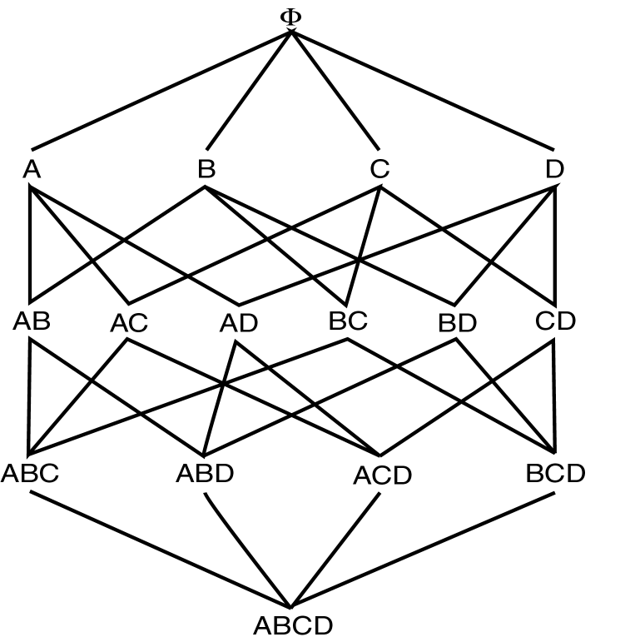
Large Itemset Property
Notes:
Dr. Navneet Goyal, BITS,Pilani
Conf = sup(LHS U RHS)
T=sup(LHS U RHS)/sup(LHS)

Slide 13


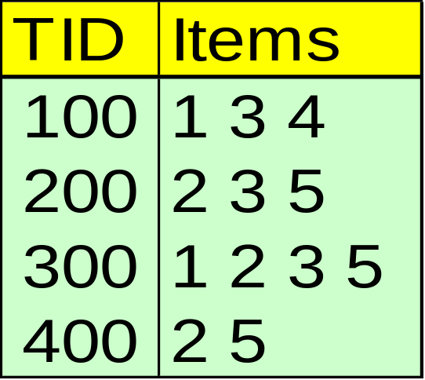





Apriori Algorithm - Example
Database D
L₁
C₁
Scan D
C₂
C₂
L₂
Scan D
C₃
Scan D
L₃
Notes:
Dr. Navneet Goyal, BITS,Pilani
Conf = sup(LHS U RHS)
T=sup(LHS U RHS)/sup(LHS)

Slide 14
Apriori Algorithm
2-Step Process
Join Step (candidate generation)
Guarantees that no candidate of length > k are generated using L_{k-1}
Prune Step
Prunes those candidate itemsets all of whose subsets are not frequent
Notes:
Dr. Navneet Goyal, BITS,Pilani
Conf = sup(LHS U RHS)
T=sup(LHS U RHS)/sup(LHS)

Slide 15
Candidate Generation
Given L_{k-1}
C_{k} = φ
For all itemsets l₁ ∈ L_{k-1} do
For all itemsets l₂ ∈ L_{k-1} do
If l₁[1] = l₂[1] ∧ l₁[2] = l₂[2] ∧…. ∧ l₁[k-1] < l₂[k-1]
Then c = l₁[1], l₁[2], l₁[3]…. l₁[k-1], l₂[k-1]
C_{k} = C_{k} U {c}
l_{1’} l₂ are itemsets in L_{k-1}
l_{i}[j] refers to the j^{th} item in l_{i}
Notes:
Dr. Navneet Goyal, BITS,Pilani
Conf = sup(LHS U RHS)
T=sup(LHS U RHS)/sup(LHS)

Slide 16
Example of Generating Candidates
L₃={abc, abd, acd, ace, bcd}
Self-joining: L₃*L₃
  abcd from abc and abd
  acde from acd and ace
Pruning:
  acde is removed because ade is not in L₃
C₄={abcd}
Notes:
Dr. Navneet Goyal, BITS,Pilani

Slide 17
ARs from FIs
ARs from FIs
For each FI l, generate all non-empty subsets of l
For each non-empty subset s of l, output the rule s ⇒ (l-s) if support_count(l)
For each FI l, generate all non-empty subsets of l
For each non-empty subset s of l, output the rule s ⇒ (l-s) if support_count(l)
Since ARs are generated from FIs, so they automatically satisfy min_sup.
min_conf
min_conf
≥
≥
support_count(s)
support_count(s)
Notes:
Dr. Navneet Goyal, BITS,Pilani

Slide 18
Example
Suppose l = {2,3,5}
{2,3}, {2.5}, {3,5}, {2}, {3}, & {5}
Association Rules are
2,3 ⇒ 5 confidence 100%
2,5 ⇒ 3 confidence 66%
3,5 ⇒ 2 confidence 100%
2 ⇒ 3,5 confidence 66%
3 ⇒ 2,5 confidence 66%
5 ⇒ 2,3 confidence 66%
Notes:
Dr. Navneet Goyal, BITS,Pilani

Slide 19
Apriori Adv/Disadv
Advantages:
  Uses large itemset property.
  Easily parallelized
  Easy to implement.
Disadvantages:
  Assumes transaction database is memory resident.
  Requires up to m database scans.
Notes:
Dr. Navneet Goyal, BITS,Pilani

Slide 20
FP Growth Algorithm
NO candidate Generation
A divide-and-conquer methodology: decompose mining tasks into smaller ones
Requires 2 scans of the Transaction DB
2 Phase algorithm
Phase I
    Construct FP tree (Requires 2 TDB scans)
Phase II
    Uses FP tree (TDB is not used)
    FP tree contains all information about FIs
Notes:
Dr. Navneet Goyal, BITS,Pilani

Slide 21
Steps in FP-Growth Algorithm
Given: Transaction DB
Step 1: Support_count for each item
Step 2: Header Table (ignore non-frequent items)
Step 3: Reduced DB (ordered FIs for each tx.)
Step 4: Build FP-tree
Step 5: Construct conditional pattern base for each node in FP tree (enumerate all paths leading to that node). Each item will have a conditional pattern base which may contain many paths
Step 6: Construct conditional FP-tree
Notes:
Dr. Navneet Goyal, BITS,Pilani

Slide 22
Construct FP-tree from a Transaction DB: Steps 1-4
TID Items bought (ordered) frequent items
100 {f, a, c, d, g, i, m, p} {f, c, a, m, p}
200 {a, b, c, f, l, m, o} {f, c, a, b, m}
300 {b, f, h, j, o} {f, b}
400 {b, c, k, s, p} {c, b, p}
500 {a, f, c, e, l, p, m, n} {f, c, a, m, p}
min_support = 0.5
{}
Steps:
Scan DB once, find frequent 1-itemset (single item pattern)
Order frequent items in frequency descending order
Scan DB again, construct FP-tree
Header Table L
Item frequency node-links
f 4
c 4
a 3
b 3
m 3
p 3
f:4
c:1
c:3
b:1
b:1
a:3
p:1
m:2
b:1
p:2
m:1
Notes:
Dr. Navneet Goyal, BITS,Pilani

Slide 23
Points to Note
4 branches in the tree
Each branch corresponds to a Tx. in the reduce Tx. DB
f:4 indicates that f appears in 4 txs. Note that 4 is also the support count of f
Total occurrences of an item in the tree = support count
To facilitate tree traversal, an item-header table is built so that each item points to its occurrences in the tree via a chain of node-links
Problem of mining of FPs in TDB is transformed to that of mining the FP-tree
Notes:
Dr. Navneet Goyal, BITS,Pilani

Slide 24
Mining FP-tree
Start with the last item in L (p in this example)
Why?
p occurs in 2 branches of the tree (found by following its chain node links from the header table)
Paths formed by these branches are:
    f c a m p:2
    c b p:1
Considering p as suffix, the prefix paths of p are:
f c a m: 2
c b: 1
Sub database that contains p
Conditional FP tree for p {(c:3)}|p
Frequent Patterns involving p: {cp:3}
Notes:
Dr. Navneet Goyal, BITS,Pilani

Slide 25
Step 5: From FP-tree to Conditional Pattern Base
Starting at the frequent header table in the FP-tree
Traverse the FP-tree by following the link of each frequent item
Accumulate all of transformed prefix paths of that item to form a conditional pattern base
Header Table
Item frequency head
f 4
c 4
a 3
b 3
m 3
p 3
{}
Conditional pattern bases
item cond. pattern base
c f:3
a fc:3
b fca:1, f:1, c:1
m fca:2, fcab:1
p fcam:2, cb:1
f:4
c:1
c:3
b:1
b:1
a:3
p:1
m:2
b:1
p:2
m:1
Notes:
Dr. Navneet Goyal, BITS,Pilani

Slide 26
Step 6: Construct Conditional FP-tree
For each pattern-base
  Accumulate the count for each item in the base
  Construct the FP-tree for the frequent items of the pattern base
{}
m-conditional pattern base:
  fca:2, fcab:1
Header Table
Item frequency head
f 4
c 4
a 3
b 3
m 3
p 3
f:4
c:1
{}
All frequent patterns concerning m
m,
fm, cm, am,
fcm, fam, cam,
fcam
c:3
b:1
b:1

a:3
p:1
f:3

m:2
b:1
c:3
p:2
m:1
a:3
m-conditional FP-tree
Notes:
Dr. Navneet Goyal, BITS,Pilani

Slide 27
Mining Frequent Patterns by Creating Conditional Pattern-Bases
Item
Conditional pattern-base
Conditional FP-tree
p
{(fcam:2), (cb:1)}
{(c:3)}|p
m
{(fca:2), (fcab:1)}
{(f:3, c:3, a:3)}|m
b
{(fca:1), (f:1), (c:1)}
Empty
a
{(fc:3)}
{(f:3, c:3)}|a
c
{(f:3)}
{(f:3)}|c
f
Empty
Empty
Notes:
Dr. Navneet Goyal, BITS,Pilani

Slide 28
Single FP-tree Path Generation
Suppose an FP-tree T has a single path P
The complete set of frequent pattern of T can be generated by enumeration of all the combinations of the sub-paths of P
{}
All frequent patterns concerning m
m,
fm, cm, am,
fcm, fam, cam,
fcam
f:3

c:3
a:3
m-conditional FP-tree
Notes:
Dr. Navneet Goyal, BITS,Pilani

Slide 29
Principles of Frequent Pattern Growth
Pattern growth property
  Let α be a frequent itemset in DB, B be α's conditional pattern base, and β be an itemset in B. Then α ∪ β is a frequent itemset in DB iff β is frequent in B.
“abcdef ” is a frequent pattern, if and only if
  “abcde ” is a frequent pattern, and
  “f ” is frequent in the set of transactions containing “abcde ”
Notes:
Dr. Navneet Goyal, BITS,Pilani

Slide 30
Why Is FP-Growth Fast?
Performance study shows
  FP-growth is an order of magnitude faster than Apriori
Reasoning
  No candidate generation, no candidate test
  Uses compact data structure
  Eliminate repeated database scan
  Basic operation is counting and FP-tree building
Notes:
Dr. Navneet Goyal, BITS,Pilani

Slide 31
Sampling Algorithm
To facilitate efficient counting of itemsets with large DBs, sampling of the DB may be used
Sampling algorithm reduces the no. of DB scans to 1 in the best case and 2 in the worst case
DB sample is drawn such that it can be memory resident
Use any algorithm, say apriori, to find FIs for the sample
These are viewed as Potentially Large (PL) itemsets and used as candidates to be counted using the entire DB
Additional candidates are determined by applying the negative border function BD⁻, against PL
BD⁻ is the minimal set of itemsets that are not in PL, but whose subsets are all in PL
Notes:
Dr. Navneet Goyal, BITS,Pilani

Slide 32
Sampling Algorithm
D_{s} = sample of Database D;
PL = Large itemsets in D_{s} using smalls (any support value less than min_sup);
C₁ = PL ∪ BD⁻(PL);
Count for itemsets in C₁ in Database using min_sup (First scan of the DB); Store in L
Missing Large Itemsets (MLI) = large itemsets in BD⁻(PL);
If MLI = ∅ (ie all FIs are in PL and none in negative border) then done
WHY? Because no superset of itemsets in PL is frequent
set C₂=L
new C₂ = C₂ U BD⁻ (C₂); do this till there is no change to C₂
Count for large items of C₂ in Database; (second scan of the DB)
While counting you can ignore those itemsets which are already known to be large
Notes:
Dr. Navneet Goyal, BITS,Pilani

Slide 33
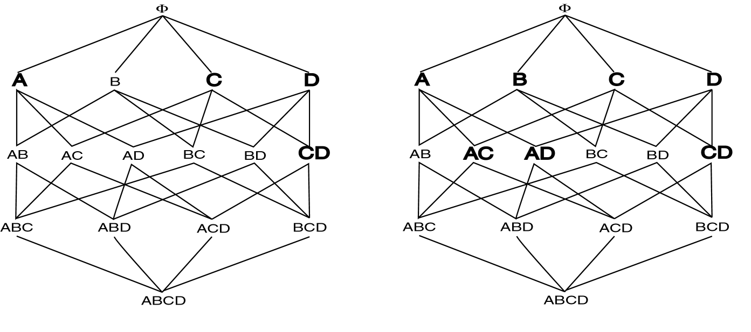
Negative Border Example
PL
PL ∪BD⁻(PL)
Notes:
Dr. Navneet Goyal, BITS,Pilani

Slide 34
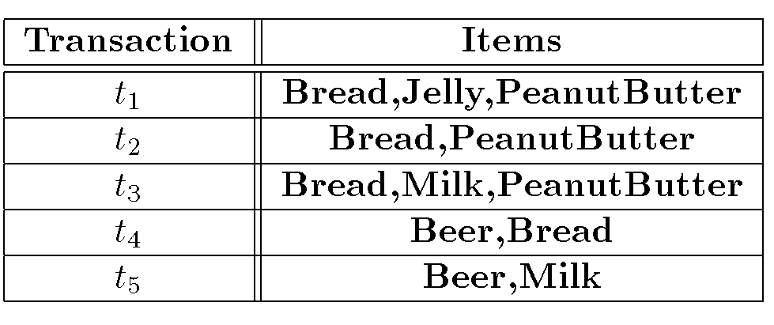
Sampling Example
Notes:
Dr. Navneet Goyal, BITS,Pilani

Slide 35
Sampling Example
Find AR assuming s = 20%
D_{s} = { t₁,t₂}
Smalls = 10%
PL = {{Bread}, {Jelly}, {PeanutButter}, {Bread,Jelly}, {Bread,PeanutButter}, {Jelly, PeanutButter}, {Bread,Jelly,PeanutButter}}
BD⁻(PL)={{Beer},{Milk}} (all 1-itemsets are by default will be in negative border)
MLI = {{Beer}, {Milk}} C = PL ∪ BD⁻(PL)={{Bread}, {Jelly}, {PeanutButter}, {Bread,Jelly}, {Bread,PeanutButter}, {Jelly, PeanutButter}, {Bread,Jelly,PeanutButter}, {Beer},{Milk}}
Repeated application of BD⁻ generates all remaining itemsets
Notes:
Dr. Navneet Goyal, BITS,Pilani

Slide 36
Sampling
Advantages:
  Reduces number of database scans to one in the best case and two in worst.
  Scales better.
Disadvantages:
  Potentially large number of candidates in second pass
Notes:
Dr. Navneet Goyal, BITS,Pilani

Slide 37
Partitioning
Divide database into partitions D¹,D²,…,D^{p}
Apply Apriori to each partition
Any large itemset must be large in at least one partition
DO YOU AGREE?
Let’s do the proof!
Remember proof by contradiction☺
Notes:
Dr. Navneet Goyal, BITS,Pilani

Slide 38

Partitioning Algorithm
Divide D into partitions D¹,D²,…,D^{p;}
For I = 1 to p do
L^{i} = Apriori(D^{i});
C = L¹ ∪ … ∪ L^{p};
Count C on D to generate L;
Do we need to count?
Is C=L?
YES
Find out yourself!!
Notes:
Dr. Navneet Goyal, BITS,Pilani

Slide 39
Partitioning Example
L1 ={{Bread}, {Jelly}, {PeanutButter}, {Bread,Jelly}, {Bread,PeanutButter}, {Jelly, PeanutButter}, {Bread,Jelly,PeanutButter}}
D¹
L² ={{Bread}, {Milk}, {PeanutButter}, {Bread,Milk}, {Bread,PeanutButter}, {Milk, PeanutButter}, {Bread,Milk,PeanutButter}, {Beer}, {Beer,Bread}, {Beer,Milk}}
D²
S=10%
Notes:
Dr. Navneet Goyal, BITS,Pilani

Slide 40
Partitioning
Advantages:
  Adapts to available main memory
  Easily parallelized
  Maximum number of database scans is two.
Disadvantages:
  May have many candidates during second scan.
Notes:
Dr. Navneet Goyal, BITS,Pilani

